Slide 1
Inquisition Trials and Procedures

Slide 2
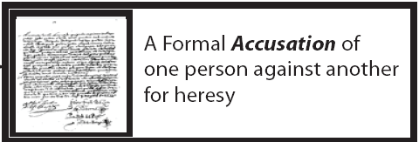
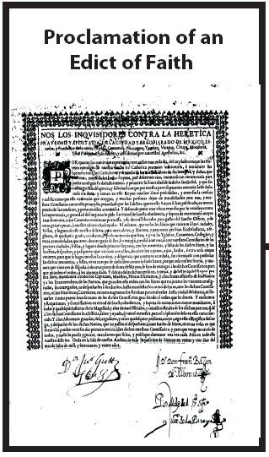
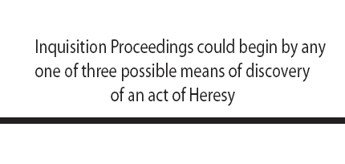
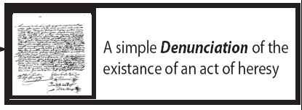
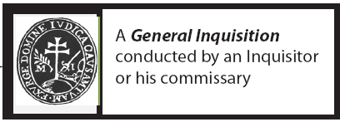
From the Edict of Faith to the Accusation of an act of Heresy

Slide 3
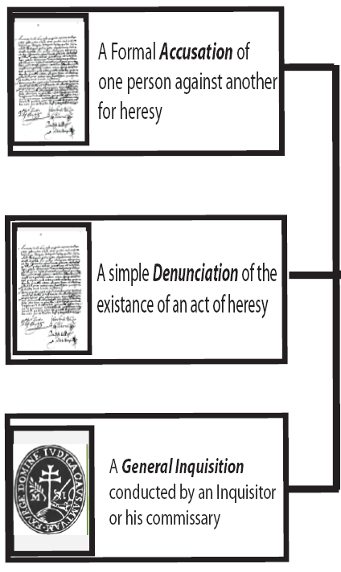
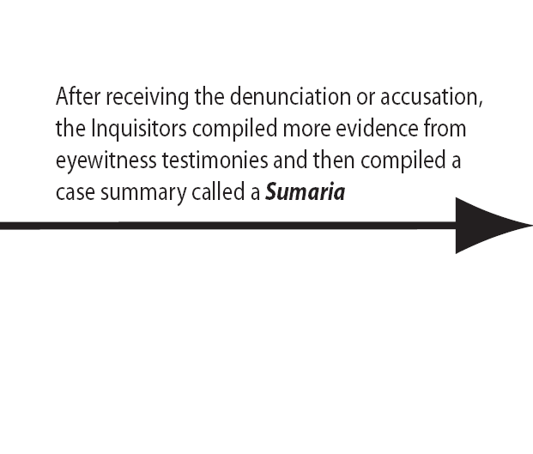
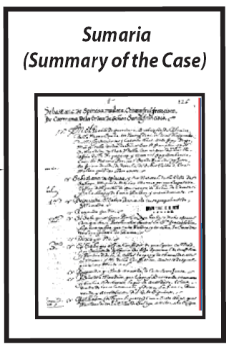
From the Denunciation to the Case Summary Stage

Slide 4
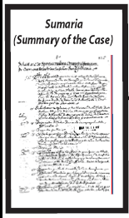
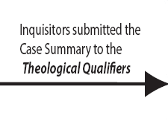
From the Case Summary to the Qualification of the Case

Slide 5
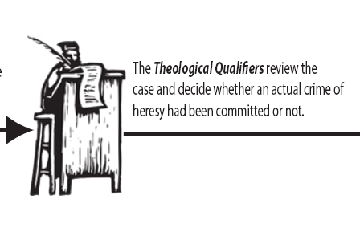
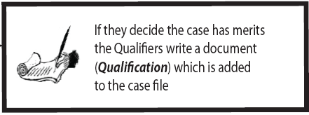
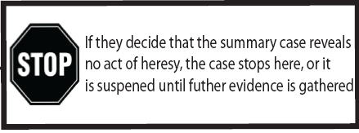
From the Case Summary to the Qualification of the Case

Slide 6
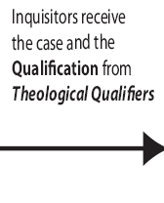
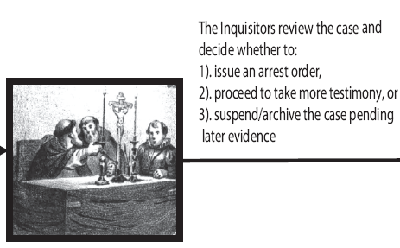
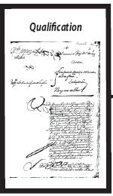
From the Qualification of the Case to the Issuing of an Arrest Warrant

Slide 7
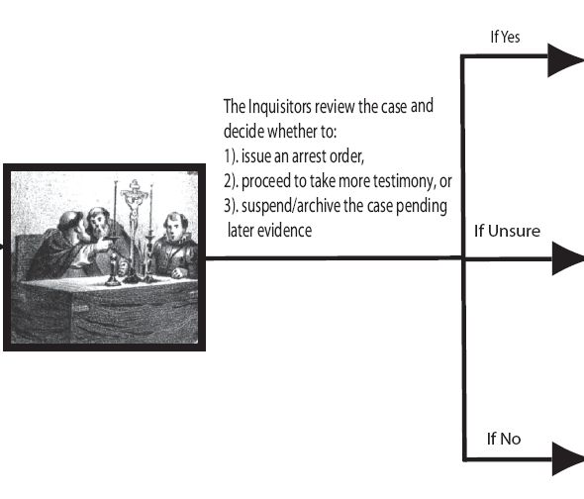
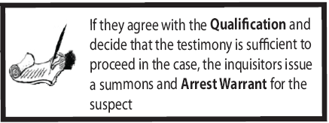
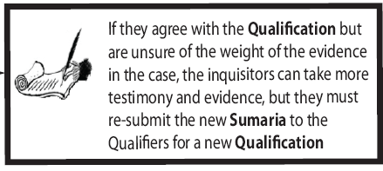
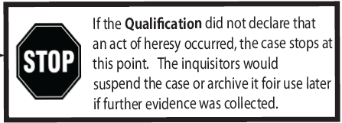
From the Qualification of the Case to the Issuing of an Arrest Warrant

Slide 8
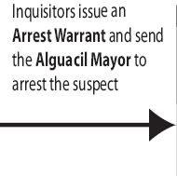
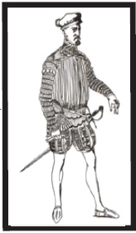
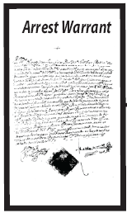
From Issuing of Arrest Warrant to Imprisonment

Slide 9
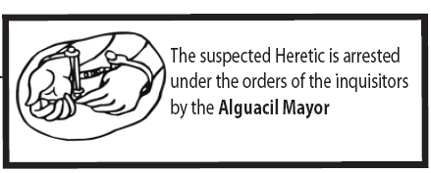
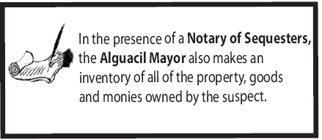
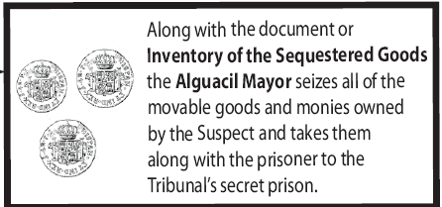
From Issuing of Arrest Warrant to Imprisonment

Slide 10
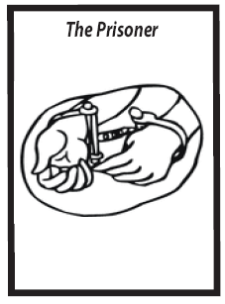
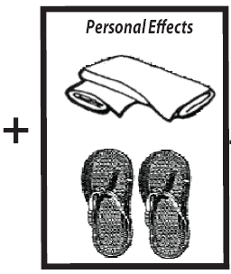
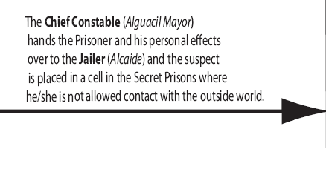
From Issuing of Arrest Warrant to Imprisonment

Slide 11
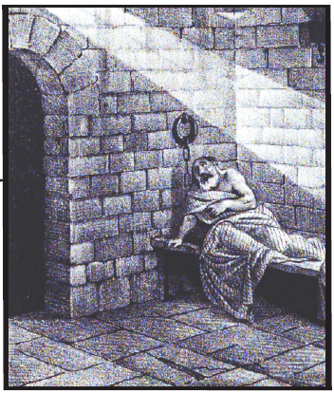
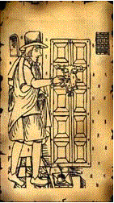
From Issuing of Arrest Warrant to Imprisonment
Jailer

Slide 12
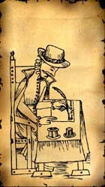
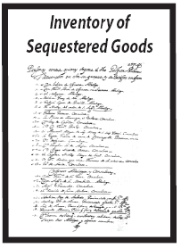
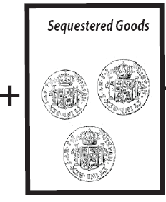
Confiscation and Sequestration of Goods
Notary of
Sequestered Goods

Slide 13
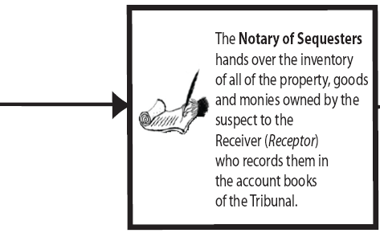
Confiscation and Sequestration of Goods
Notary of
Sequestered Goods

Slide 14
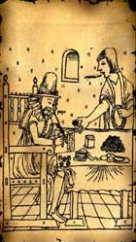
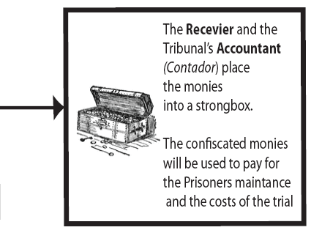
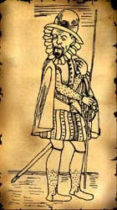
Confiscation and Sequestration of Goods
Accountant
Receiver

Slide 15
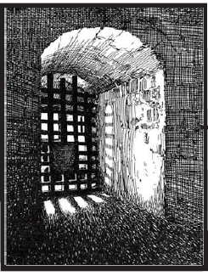
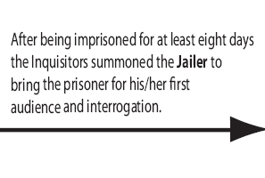
Imprisonment to Initial Hearing
Jailer

Slide 16
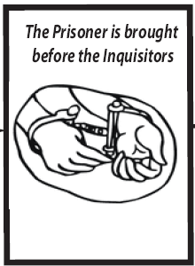
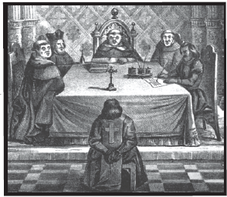
Imprisonment to Initial Hearing
Jailer

Slide 17
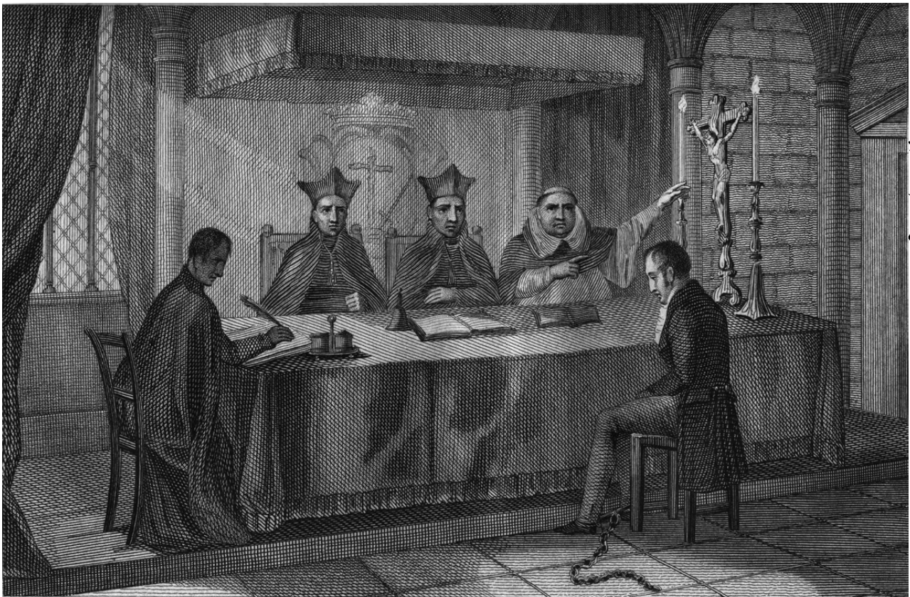

Slide 18
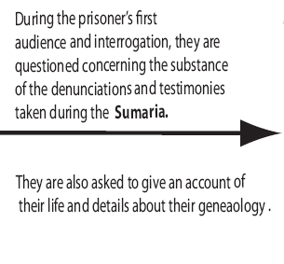
Imprisonment to Initial Hearing

Slide 19
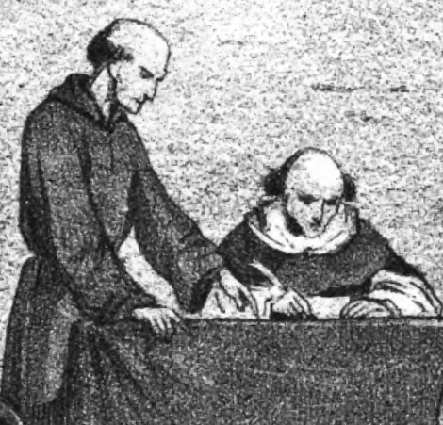
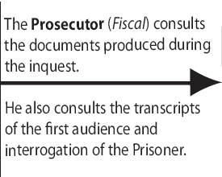
From the Initial Hearings to the Prosecutor’s formal Accusation
Fiscal

Slide 20
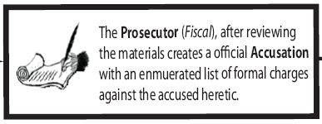
From the Initial Hearings to the Prosecutor’s formal Accusation

Slide 21
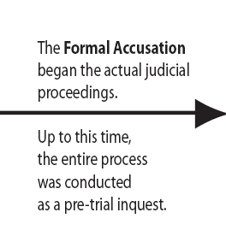
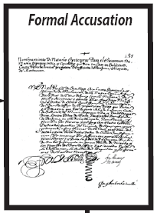
From the Initial Hearings to the Prosecutor’s formal Accusation

Slide 22
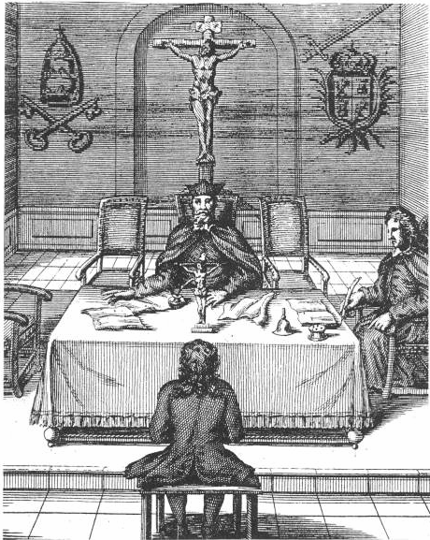
From the Initial Hearings to the Prosecutor’s formal Accusation
Jailer

Slide 23
From the Initial Hearings to the Prosecutor’s formal Accusation
Fiscal

Slide 24
From the Initial Hearings to the Prosecutor’s formal Accusation

Slide 25
From the Initial Hearings to the Prosecutor’s formal Accusation

Slide 26
Formal Defense Strategies of the Accused

Slide 27
Formal Defense Strategies of the Accused

Slide 28
Formal Defense Strategies of the Accused

Slide 29
Interrogation under Torture During the Proof Stage

Slide 30
"Prisoner Being Shown the Implements of Torture"

Slide 31
The Garrucha Torture

Slide 32
Torture of the “Chords”

Slide 33
Water Torture

Slide 34
From Confession to the Final Verdict and Sentencing in the Case

Slide 35
Verdicts and Punishments

Slide 37
Public Humiliation: The San Benito or Garment of Shame

Slide 47
Penalties and Punishments Imposed on Convicted Heretics

