Slide 1
Reconstruction & Visualizing the Palace of the Inquisition
Mexico City, 1601

Slide 2
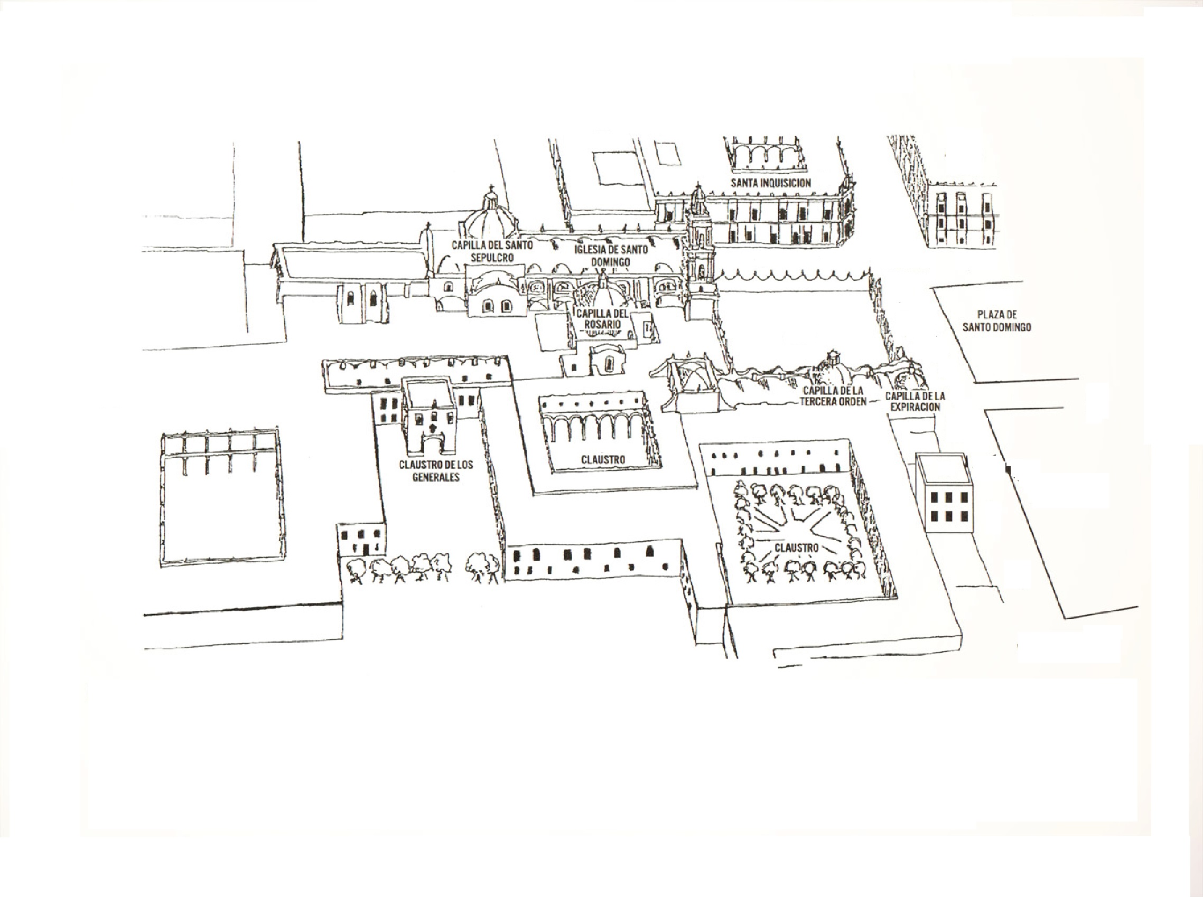
Plaza of Santo Domingo
(Location of the Palace of the Inquisition & Dominican Convent)
The Location of the Palace of the Inquisition

Slide 3
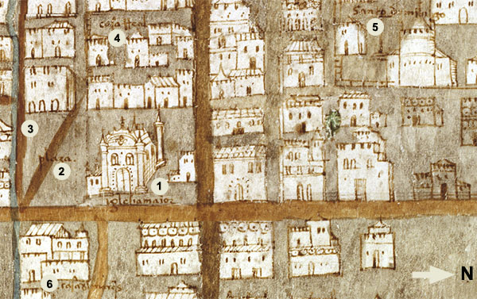
Central Plaza in 1575
Earliest image of the Palace of the Inquisition

Slide 4
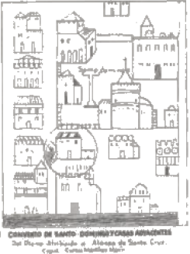
History of the Palace of the Inquisition, 1578-1650
Important Dates
1569: Inquisition Established in New Spain by Royal Order
1571: The First Inquisitors are housed in the Dominican Monastery
1578:On July 14, 1578, the Tribunal purchases the building
1594: The Tribunal purchases the building next to it to serve as the Perpetual Prison (Cárcel Pepetua) of the Holy Office.
1600: Renovations begin and expansion of building
1649: By this date the palace occupied more than half of the entire city block
Earliest diagram of the Palace of the Inquisition, 1579

Slide 5
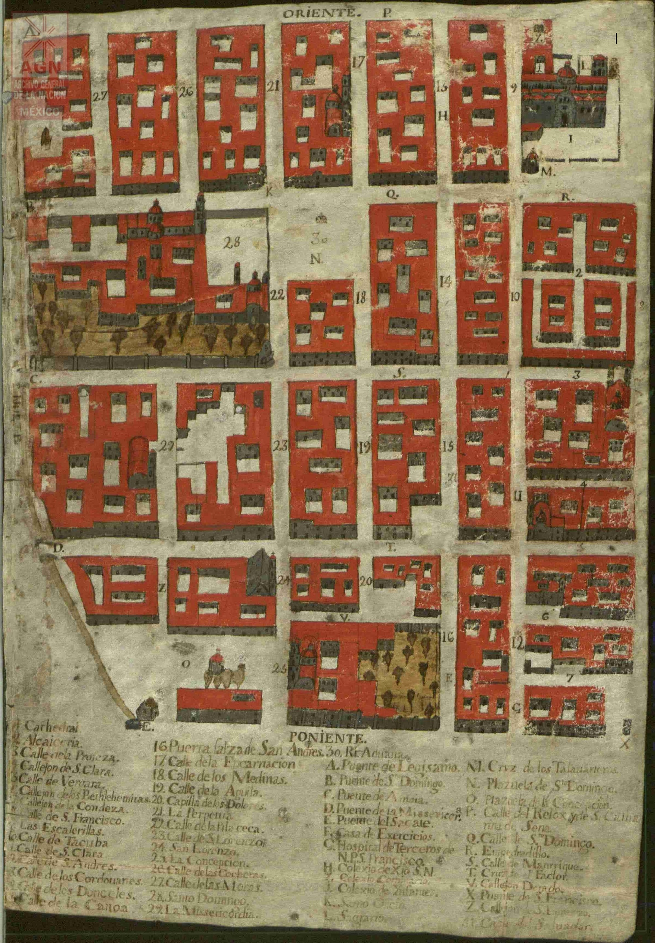
Palace of the Inquisition
Plaza de Santo Domingo

Slide 6
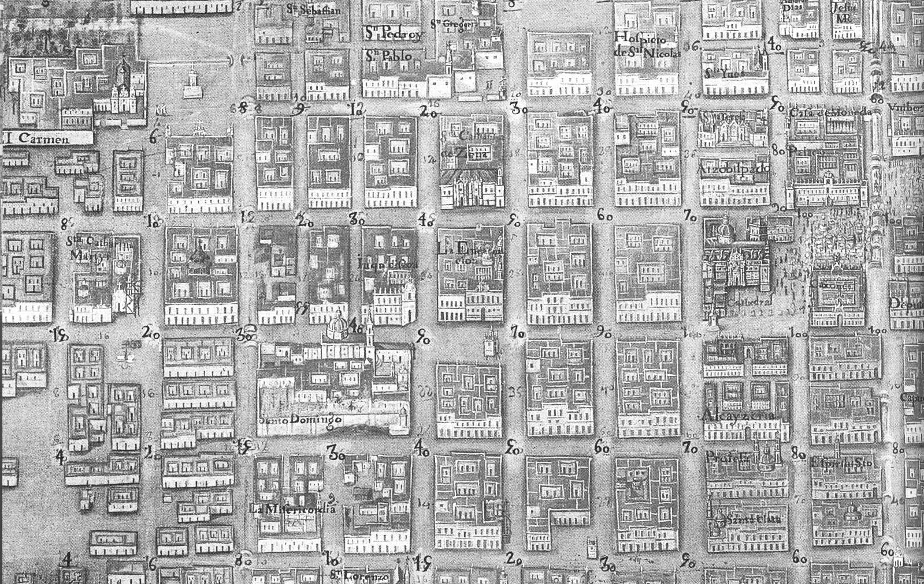
Late 17th century image of he Palace of the Inquisition

Slide 7
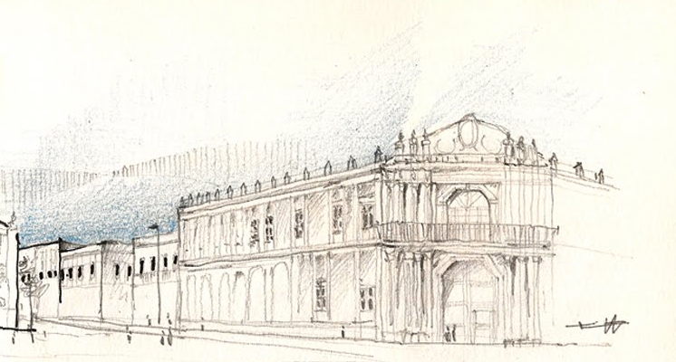
Palace of the Inquisition
(From 1980s Building Preservation Work)
Dr. Inés Ortiz Bobadilla

Slide 8
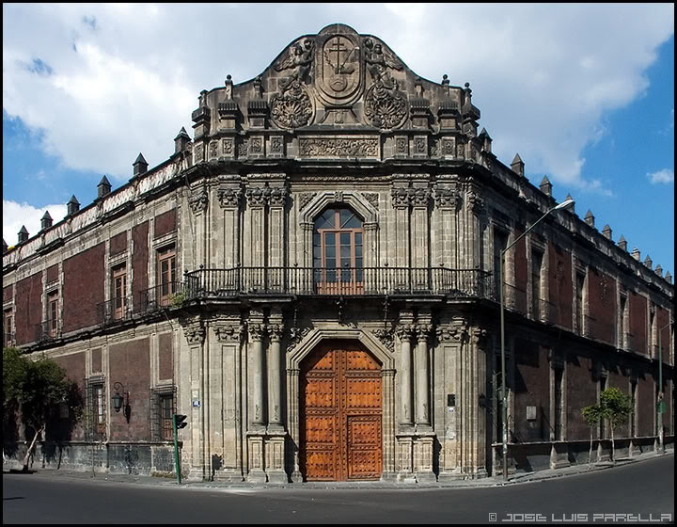

Slide 9
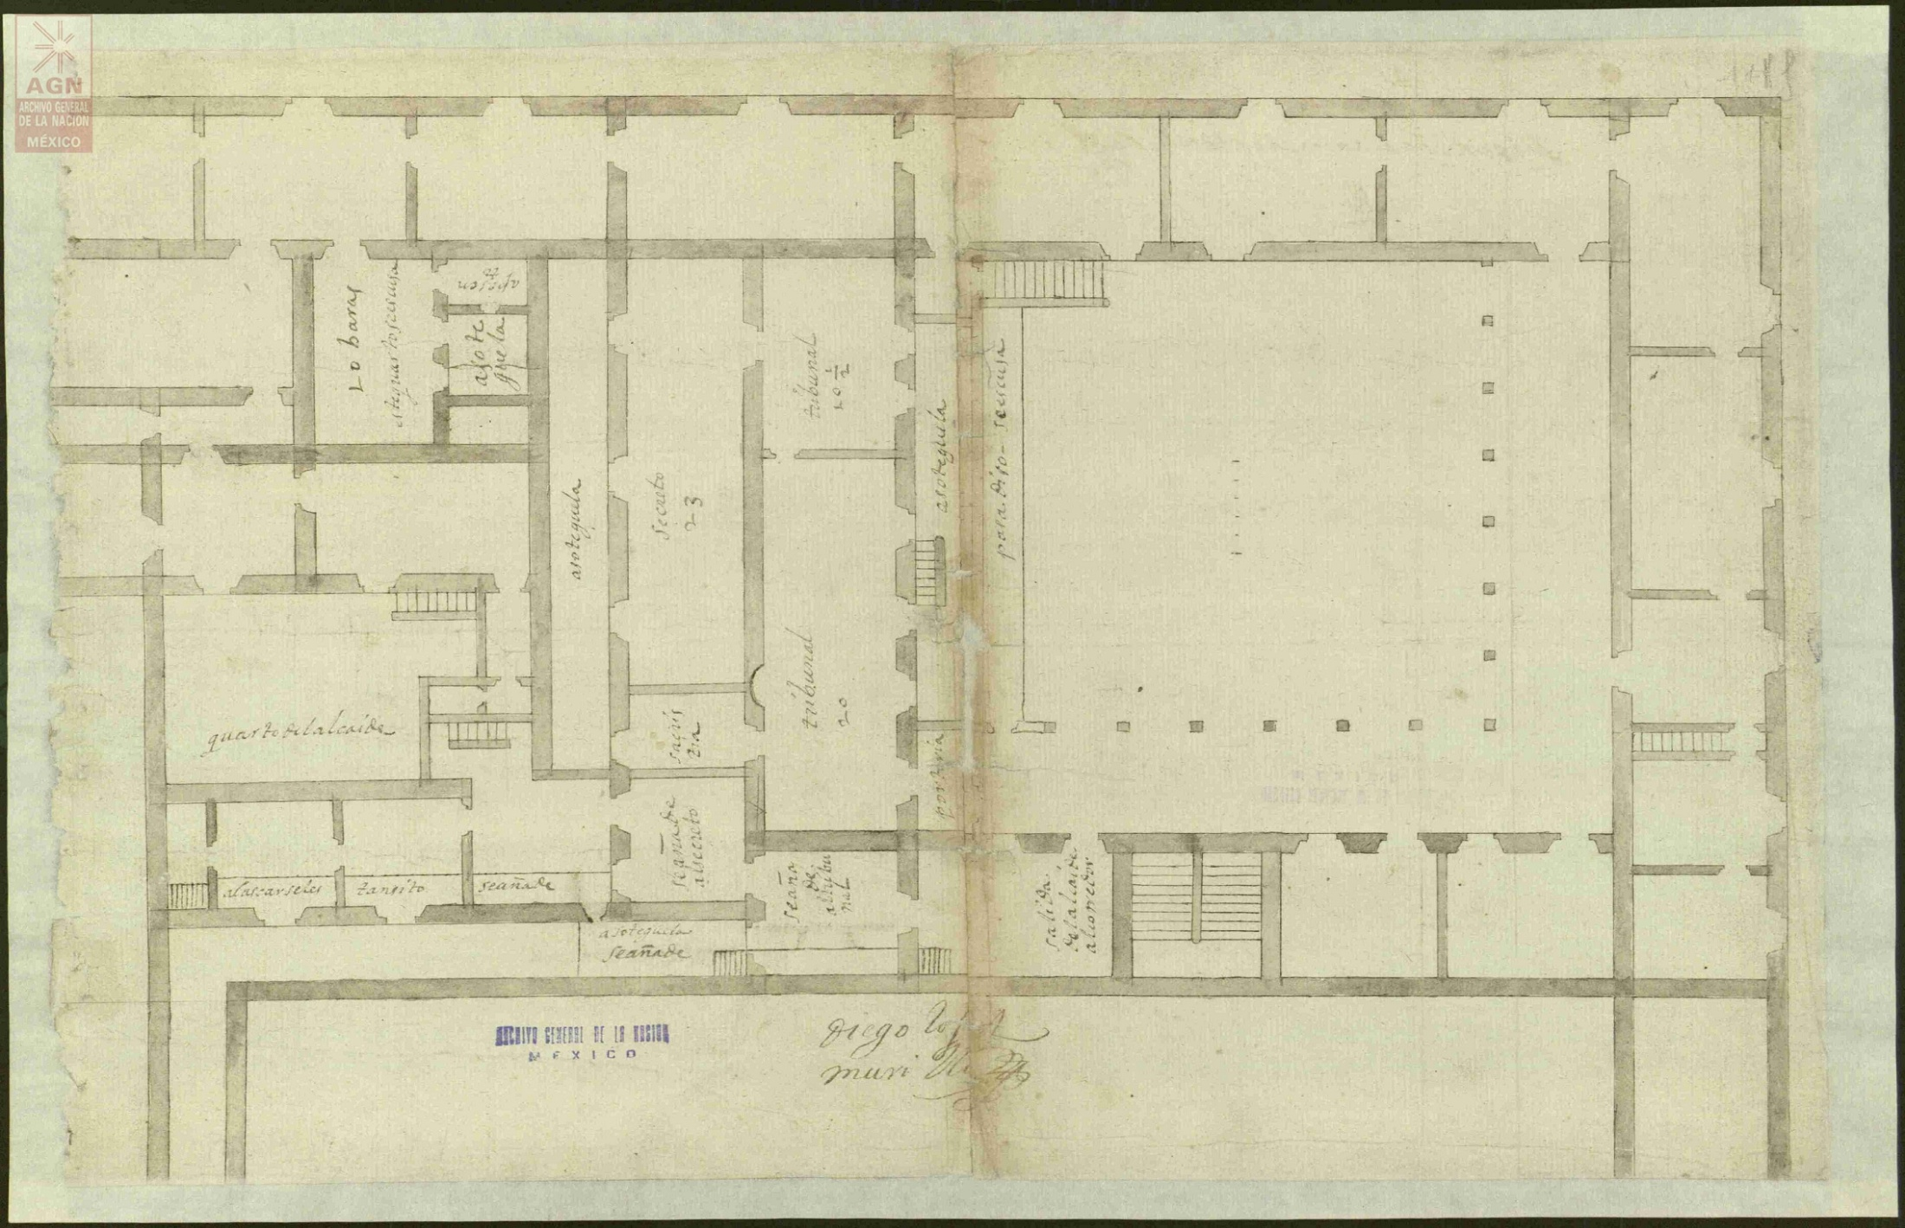
Map of the Interior of the Palace of the Inquisition (1655)

Slide 10
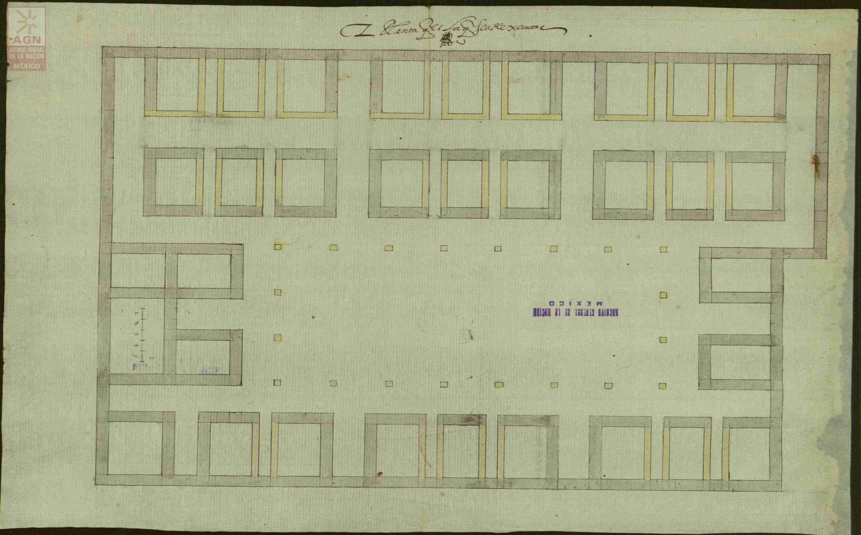
Plan for the Secret Prisons of the Palace of the Inquisicion

Slide 11
First Floor Plan (ca. 1650s)

Slide 12
Second Floor Plan (ca. 1650s)

Slide 13
Plan of the Palace and Prisons

Slide 14
External Condition of the Palace

Slide 15
Aritectural Preservation and Repairs (ca. 1980s)

Slide 16
Pavement & Colonial Tiles in patio (White Marbel and Black Granite)
See mock up of paving in animation of
Inquisitor Don Alonso de Peralta
(https://www.youtube.com/watch?v=0H5JlhX4Wrw)

Slide 17
The Secret Prisons
(Cárcel de la Perpetua)

Slide 19
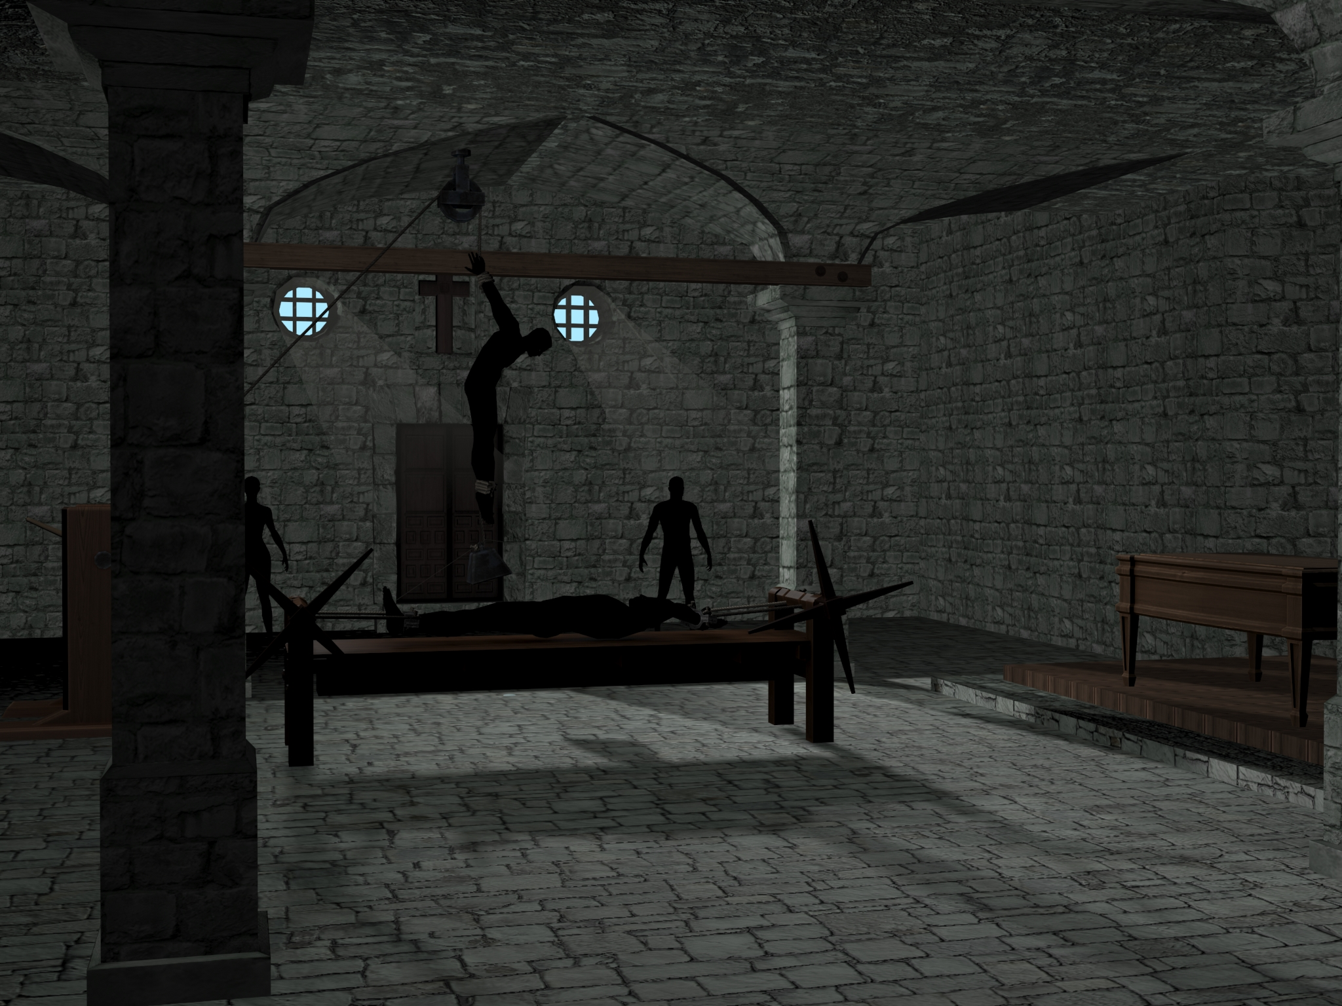
Mock up based on archaeological evidence and plans of the Interior of the “Sala de Tormento” in the Palace of the Inquisition

